Slide 1


Slide 2
TEAM 6: Himanshu, Karan, Tien, Vikas, Youngsuk

Slide 3
Introduction
Stock market is very sensitive to external and random noise, which makes the price prediction often meaningless.
Most of the current machine learning techniques predict the prices of an asset on different time frames without risk or confidence measures.
Limitations on the usage of technical indicators that many successful traders use together with the models like RSI, MACD etc.. These indicators need to be accounted for in our model.
Cryptocurrencies has drawn a lot of attention recently and has openly available datasets (live and historical), which can be used to test our models effectively.

Slide 4
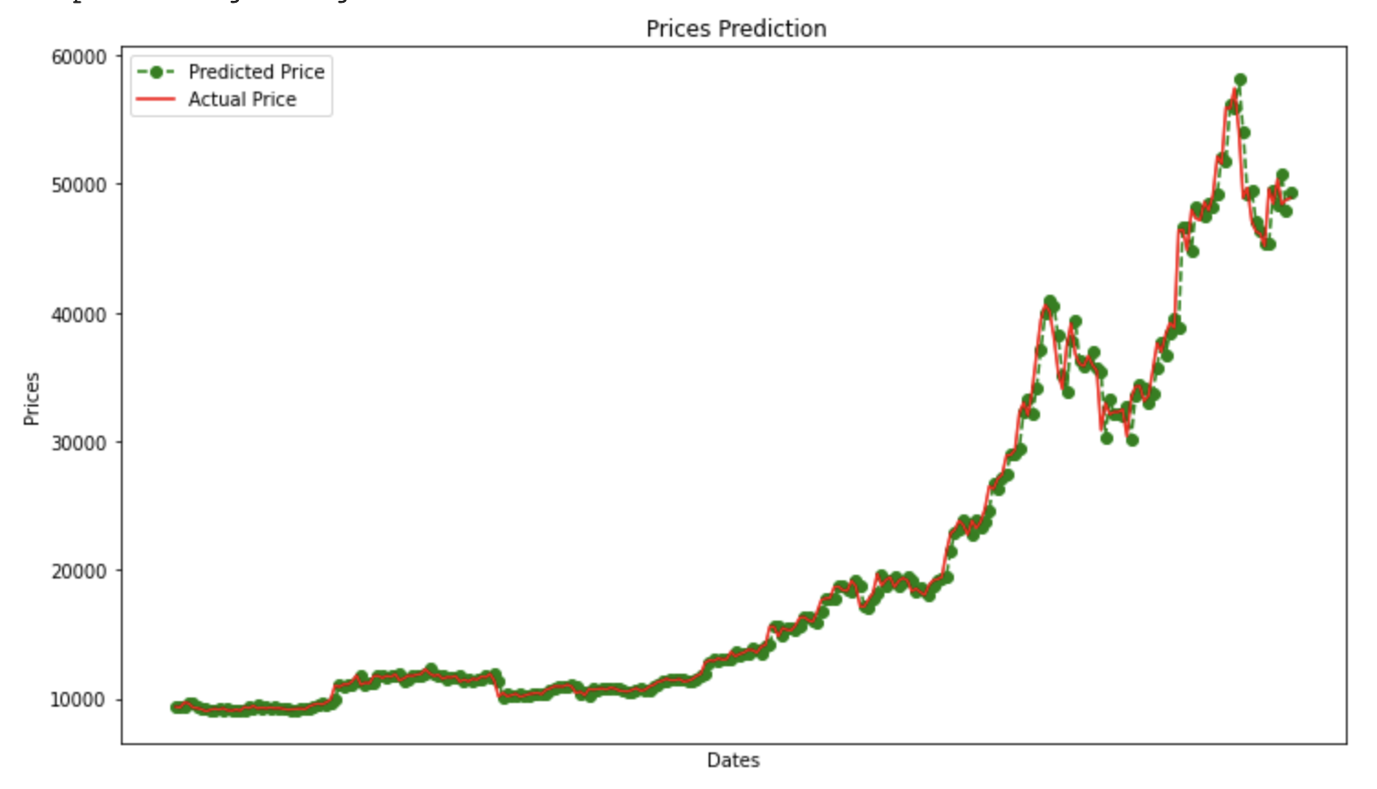
ARIMA (Statistical Time Series Analysis)
An example of Machine Learning models that have been created in order to predict stock price is ARIMA (AutoRegressive Integrated Moving Average) model.
In order to evaluate the ARIMA model, we used the error function called Symmetric Mean Absolute Percentage Error (SMAPE), which is commonly used as an accuracy measure based on relative errors
We used p=5, d=1 and q=0 as the ARIMA parameters for our implementation
The result from this model offers a pretty good prediction accuracy and the training process is relatively fast.
Note that this model only predicts prices and doesn’t predict trend. Therefore, we also tried different models that can achieve our objective of predicting trend.

Slide 5
Models
Supervised Learning
Decision Tree- helps us identify a set of 2-3 indicators that perform best in predicting stock trend
Linear Models: Ridge Classifier, Logistic Regression
Support Vector Machine (SVM)
Unsupervised Learning: Principal Component Analysis
Reinforcement Learning
Dataset
Binance API - multiple time frames and historical data available

Slide 6
Supervised Learning - Decision Tree
Used sklearn.tree.DecisionTreeClassifier
Considered 8 commonly used indicators ( SMA21, SMA50, EMA21, EMA50, RSI, MFI, ADX, ATR ) as features, among which 3 of them are randomly selected and provided as features to the decision tree
The classification is done separately for 'BUY' or 'Long' and 'SELL' or 'Short' based on the truth labels
Repeated the process several times and selected the indicator set with the highest accuracy as the most relevant indicators to be used.

Slide 7
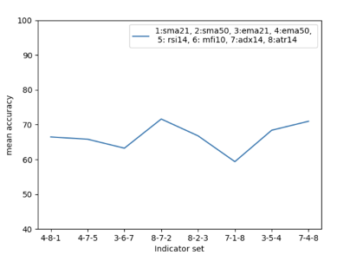


Supervised Learning - Decision Tree
The focus here is not on the absolute metric of accuracy but rather the relative measure of accuracy among different indicator sets.
An example of one branch in the tree -> |--- 2 > 10808.51
||--- 8 <= 1208.95
|||--- 7 <= 28.66
||||--- class: True
Good set
Bad set

Slide 8
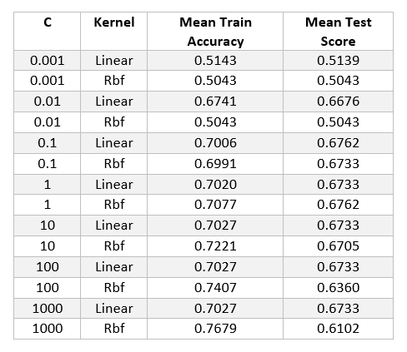
Supervised Learning - SVM
We checked the accuracy of the SVM model using radial and linear kernels on various C Parameter and decided to pick C = 1 as an optimum value.
The SVM model trained on the truncated datasets provide the test set accuracy of around 68% The model results look promising, and can be used in predicting the buy and sell signals
Notes:
We explored Supervised machine learning model - support vector machine (SVM) for predicting the buy/ sell signal based on the values of technical indicators.
We used SVM's linear and non-linear radial kernal for classification. We used the cleaned balanced data (50/50).
We checked the accuracy of the SVM model on various C Parameter with gamma value set to auto.
C Parameter tells the SVM optimization how much mis-classification you want to avoid on each training example.
For large values of C, the optimization chooses a smaller-margin hyperplane if that hyperplane does a better
job of getting all the training points classified correctly. As large values of C could lead to overfitting
and small values lead to lower accuracy, We picked C =1 as an optimum value. The SVM model trained on the
truncated datasets provide the best score of around 68% on test dataset with C=1 and a radial kernel.
So we can conclude that it can be a good model to predict buy and sell signal.we can say that the linear models succeeded in finding a decision boundary that has better classification accuracy than a coin-toss.

Slide 9
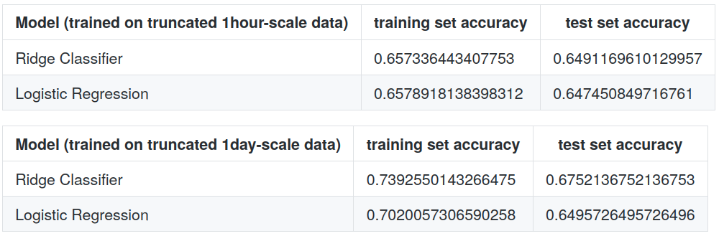
Supervised Learning - Linear Models
Used Ridge Classifier and Logistic Regression (from scikit-learn) for predicting BUY signals
We achieved a high accuracy of 80% on our original unbalanced dataset.
After leveling the proportions of the truth labels, we obtained an accuracy of 65%~67% on test sets

Slide 10
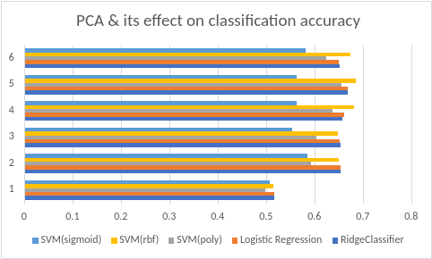
Unsupervised Learning - PCA
On a feature vector with 6 technical indicators (EMA, SMA, MFI, RSI, ADX, ATR) we applied PCA
Setting n_components = 5 resulted in a 2~4% increase in classification accuracy (vs using all 6 features)
Setting n_components < 5 Resulted in a lower classification accuracy compared to the models trained with all 6 features

Slide 11
Reinforcement Learning
Tried two approaches of RL.
Q-Learning
Proximal Policy Optimization.
Both approaches were used using an LSTM neural network with 3 hidden layers
The network input is fed with log differenced close price and the RSI and MACD indicators.
The reward strategy for both networks was based on the sharpe ratio for the returns.
The network model was trained with a discrete action space, i.e. Buy, Sell and Hold.
Used TensorTrade as the simulated trading environment
And ray-rllib as the framework for training algorithms

Slide 12
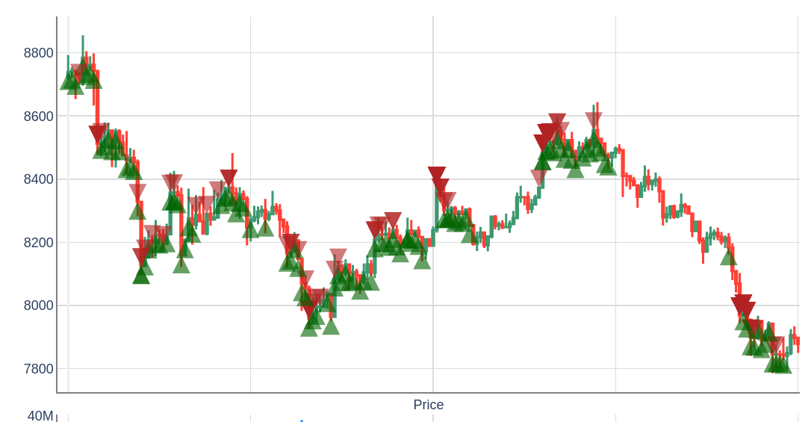
Reinforcement Learning: Q-Learning Agent
DQN Agent Actions

Slide 13
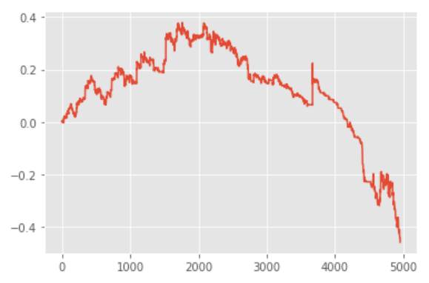
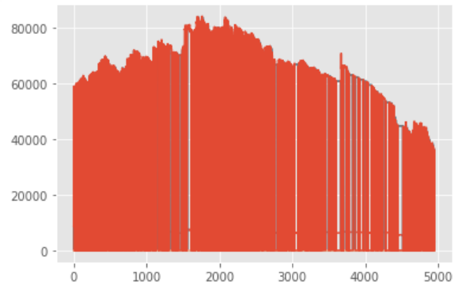
Reinforcement Learning: PPO Agent
Mean reward plot and Networth plot for evaluation

Slide 14
Discussion
We employed proven technical indicators along with our model to make our decisions. Decision Trees are used for this purpose and future scope could also involve using clustering techniques to group similarly trending assets to create a portfolio or diversify the risk
Testing with live data could present a different set of challenges and we need to make our model more adaptive to it.
The goal of the model is not about developing a auto trading bot or to predict the prices but to identify the market conditions and the trend of the underlying asset in order to assist traders make better decisions.

